Slide 1

Presentation on SPAM DETECTION TEXT

Slide 2
Agenda
Introduction
Problem Statements
Problem Understanding
Definition and Importance Comments Classification
Data Analysis and Model Building Flowchart
Exploratory Data Analysis Steps
Data Analysis Steps Done
Model Building
Hyper Parameter Tuning and Crating Final Model
Saving the model and Prediction results
Conclusion

Slide 3
Introduction
Spam is any kind of unwanted, unsolicited digital communication that gets sent out in bulk. Often spam is sent via email, but it can also be distributed via text messages, phone calls, or social media.
Spammers use many forms of communication to bulk-send their unwanted messages. Some of these are marketing messages peddling unsolicited goods. Other types of spam messages can spread malware, trick you into divulging personal information or scare you into thinking you need to pay to get out of trouble.
Email spam filters catch many of these types of messages, and phone carriers often warn you of a “spam risk” from unknown callers. Whether via email, text, phone, or social media, some spam messages do get through, and you want to be able to recognize them and avoid these threats.

Slide 4
Problem Staments
Like robocalls, phishing emails and spam calls, smishing, spam text messages and text scams are on the rise. Typically, smishing scammers will send you text messages that attempt to get you to click a link and then provide personal or financial information about yourself. Smishing is serious and can lead to identity theft. You can report a fraud or identity theft complaint to the Federal Trade Commission.
The statistics speak for themselves. In the United States, $86 million was reported lost in 2020 from frauds originating in scam texts, according to the Federal Trade Commission (FTC). In 2020, 334,524 complaints were made, which equaled an average of 916 reports a day. The Federal Communications Commission (FCC), heard about 14,000 complaints about scam texts last year. This year there have been 6,900 reports up until late May and the numbers are on the rise, suggesting that the 2020 total will be surpassed in 2021.

Slide 5
Problem Unserstanding
Knowing what to do and blocking spam texts is one of the best ways to prevent future spam texts and keep your information secure. We’ll be discussing general spam handling and text blocking on iPhones and blocking spam texts on Android phones. And of course, the resources Verizon has for you to block spam texts.
Spam is any kind of unwanted, unsolicited digital communication that gets sent out in bulk. Often spam is sent via email, but it can also be distributed via text messages, phone calls, or social media.

Slide 6
Importance of spam Detection text
Implementing spam filtering is extremely important for any organization. Not only does spam filtering help keep garbage out of email inboxes, but it also helps with the quality of life of business emails because they run smoothly and are only used for their desired purpose. Spam filtering is essentially an anti-malware tool, as many attacks through email are trying to trick users to click on a malicious attachment, asking them to supply their credentials, and much more.
Nowadays, every site and application uses a machine-learning approach. Machine Learning has simplified the task that may take a long duration to complete without it. Most of the approaches require text analysis and classification techniques. Classification of the comments is necessary before posting on online platforms. This classification model helps to prevent online abuse and cyberbullying.

Slide 7
Data Analysis and Model Building Flowchart
Import Libraries
Import Dataset
Feature Engineering
Checking Correlation
NLTK Text Pre-Processing
Visualizations
(EDA)
TF-IDF Vectorizer
Data Balancing
Model Building
Saving the model and Predictions
AUC-ROC Curve
Hyper Parameter Tuning

Slide 8
Exploratory Data Analysis Steps
Importing necessary libraries and importing datasets as a data frame.
Checked some statistical information like shape, several unique values present, info, finding zero values, etc.
Checked for null values and find null values. And removed it.
Done feature engineering and created new columns viz label: which contain both spams and not spam texts.
Visualized each feature using seaborn and matplotlib libraries by plotting count plots like pie plots, count plots, and word clouds for each label.
Done text pre-processing techniques like Removing Punctuations and other special characters, Splitting the comments into individual words, Removing Stop Words, Stemming, and Lemmatization. Then created a new column as text_nlp after cleaning the data. All these steps were done on both train and test datasets. Checked correlation using heatmap. After getting cleaned data used the TF-IDF vectorizer.

Slide 9
Data Analysis Steps Done
I have extracted some features and removed the feature where null values are present a lot of for to improve data normality and linearity.
Done text pre-processing techniques like
Removing Punctuations and other special characters,
Splitting the comments into individual words,
Removing Stop Words,
Stemming and Lemmatization.
Then created new column as text nlp after cleaning the data. All these steps were done on both train and test datasets.
After getting cleaned data used the TF-IDF vectorizer. It’ll help to transform the text data into a feature vector that can be used as input modeling. It is a common algorithm to transform the text into numbers. It measures the originality of a word by comparing the frequency of appearance of a word in a document with the number of documents the words appear in.
Split train and test to build machine learning models. The model-building process will be shown in further steps.

Slide 10
Model Building
In this project 6 features define the type of text feature named “label” which is combined all the above features and contains the labeled data into the format of 0 and 1 where 0 represents “NO” and 1 represents “Yes”. In this NLP-based project, we need to predict binary text. I have converted text into feature vectors using TF-IDF vectorizer and separated our features and labels. Also, before building the model, I made sure that the input data is cleaned and scaled before it was fed into the machine-learning models.
After the pre-processing and data cleaning I used the remaining independent features for model building and prediction. The classification algorithms used in training the data are as follows:
Logistic Regression
MultinomialNB
GaussianNB
BernoulliNB
Decision tree Classifier
Kneighbors Classifier
Ada boost Classifier
Gradient Boosting Classifier
Random Forest Classifier

Slide 11
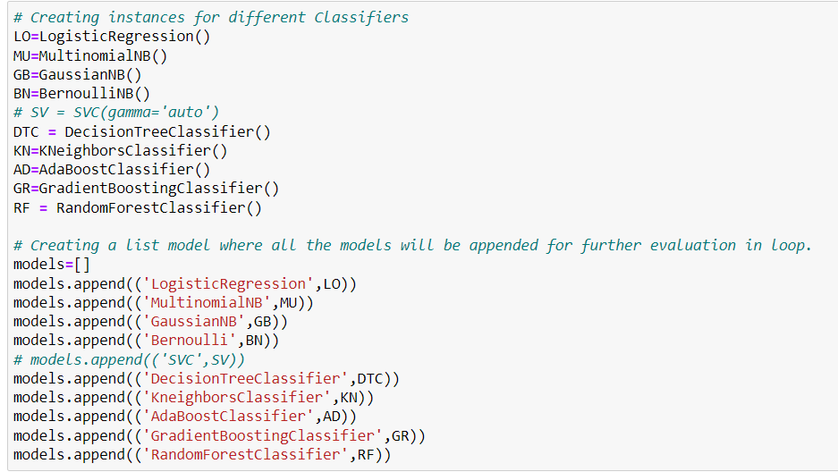
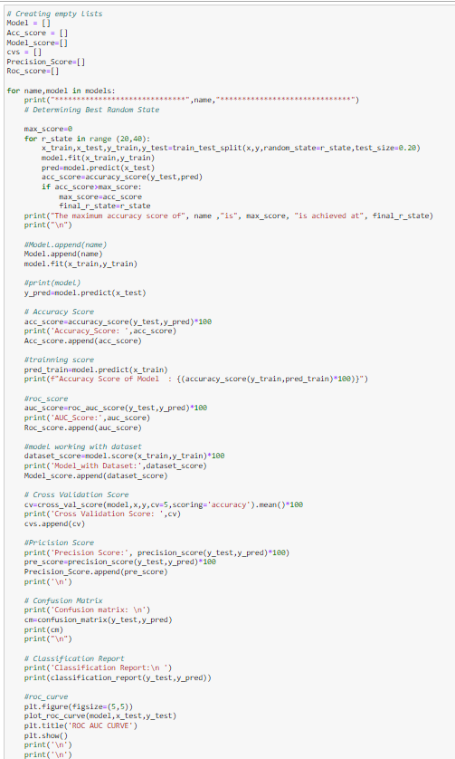
First, create instances for different classifiers and then listed down the models that will be appended for further evaluation in for loop

Slide 12
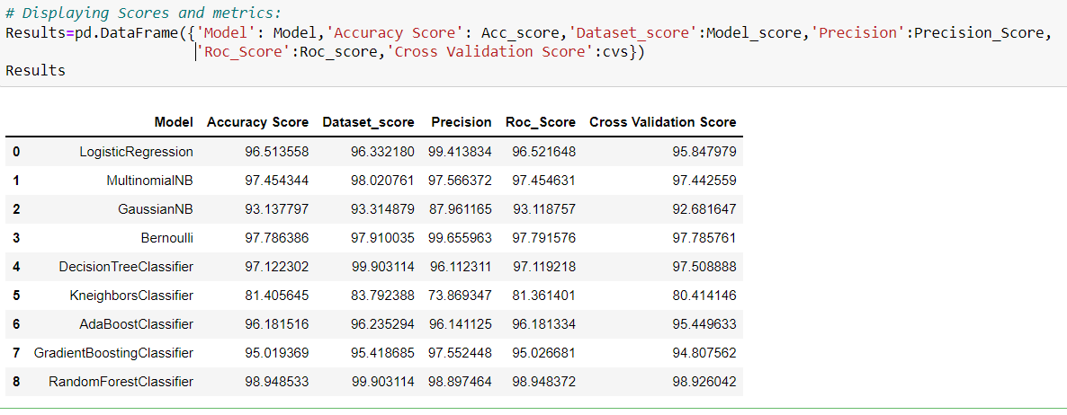
After creating and training different classification algorithms, we can see that the difference between accuracy and cross-validation score is less for the “Random forest Classifier” and Bernoulli. But, Random Forest Classifier gives fewer loss values, auc roc score, and high accuracy score compared to Bernoulli. On this basis, I can conclude that the “Random Forest Classifier" is the best-fitting model. Now, we will try Hyperparameter Tuning to find out the best parameters and use them to improve the scores and metrics values.

Slide 13
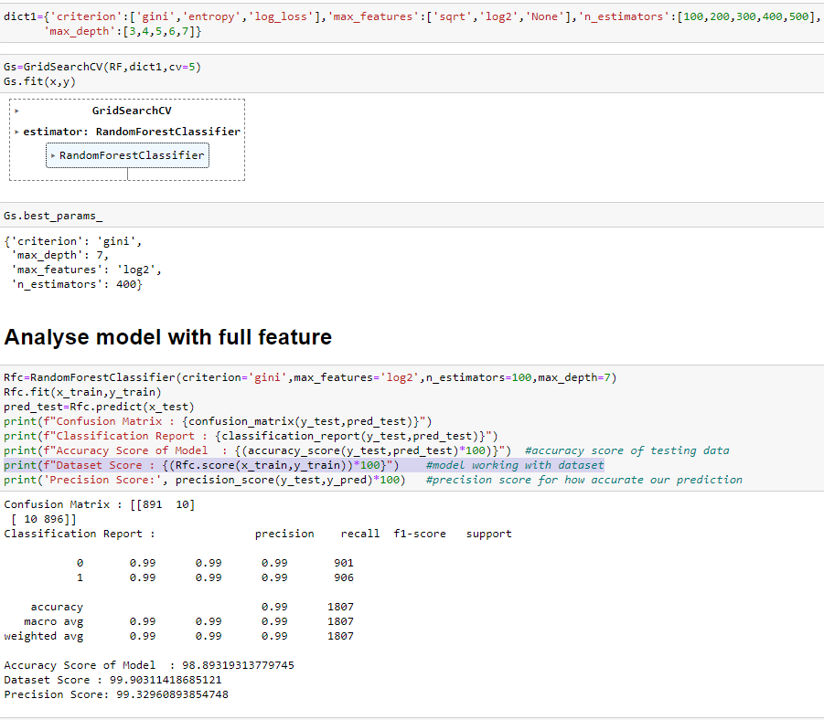
HYPER PARAMETER OF RANDOM FOREST CLASSIFIER
In Hyper parameter tuning of Random Forest Classifier, we got maximum accuracy and precision score compared to other models

Slide 14
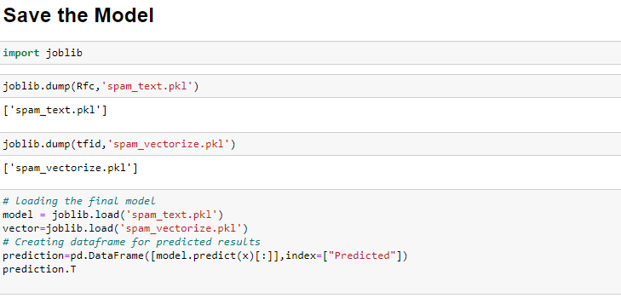
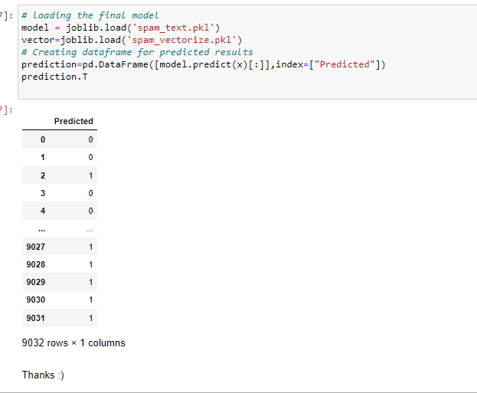
I have saved my final best model by joblib library in pkl format and loaded the saved model for prediction

Slide 15
Conclusion
This case study gives an idea of NLP text processing in machine learning. In this case study, apart from applying the techniques that we have learned in the EDA module, we also classified hate and offensive comments so that they can be controlled and restricted from spam text.
From this dataset we were able to understand the idea of Natural Language Processing using machine learning models. This model helps us to understand whether text are spam and not.
We have mentioned step by step procedure to analyze the data and checked the correlation between label and feature.
In this project there are some variables like spam and ham which are highly correlated it is possible because one c text may have a combination of multiple features.
• Removing the null values does not impact the model training.
• Using a Tree, the model can reduce the false negative values
• It has future scope in various use cases likewise in elections, social media, etc, where every day there are multi offensive comments spread.
Data cleaning is one of the most important steps to remove unrealistic values and unnecessary stop words.
We got Random Forest Classifier as the best model and performed hyperparameter tuning using the best parameters of the RFC model and precision score and the model accuracy and roc-auc score increased after tuning.
After that we saved the model in a pickle with a filename in order to use it whenever we require. Then we loaded the saved file and predicted the values for test data. Further, we saved the predicted values test data into csv file.

Slide 16
THANKS

